Slide 1
HUL271 Presentation
Harsh reality of Child Labor in the
Industrial revolution

Slide 2
Team Members:
Aditya Singh 2020MS10740
Nithin Banoth 2021EE30749
Vanchanagiri Alekhya 2020EE10565
Guttikonda Veera Teja 2021CS10107
Gurram Hari Charan 2021CS10092

Slide 3
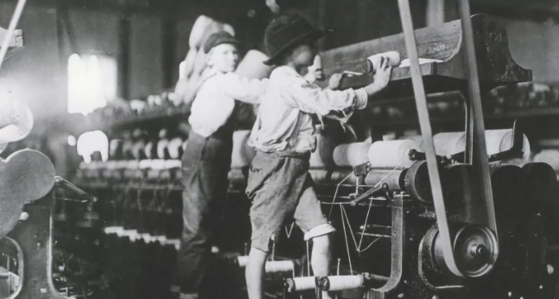
Contents:
Introduction
Historical context
Causes that led to child labor
The working conditions
Impact on children
Opposition and laws
Global impact
Conlcusion

Slide 4
Introduction

Slide 5
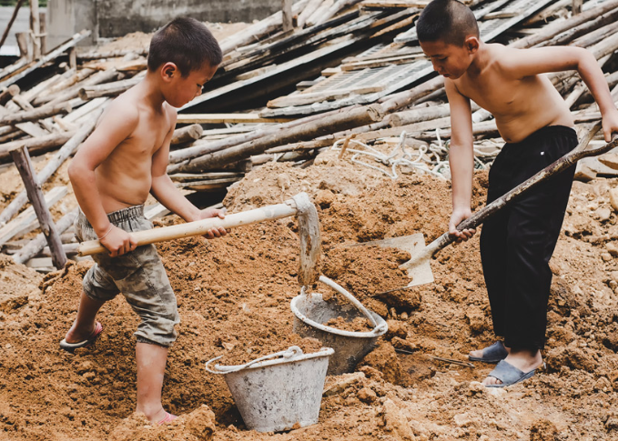
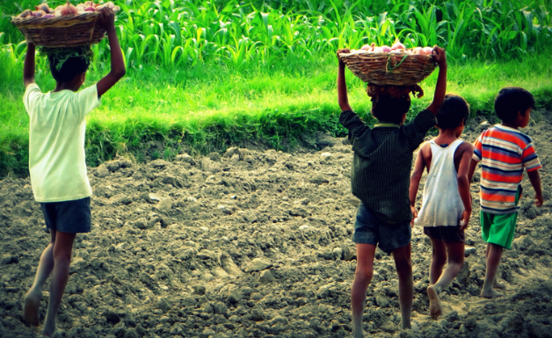
Definition:
employment of children in any kind of work that deprives them of their childhood, education, potential, and dignity
paid or unpaid work
include activities such as agriculture, domestic service, manufacturing, mining, and other industries

Slide 6
How Industrial revolution led to the rise of child labor

Slide 7
period of rapid industrialization (18th to the 19th century) primarily in Britain and later spread to other countries in Europe and North America.
significant changes in the way goods were produced
massive demand for labor in factories, mines, and other industries
employers often struggled to find enough workers
led them to turn to children as a source of cheap and easily manageable labor
Families struggling to make ends meet
a way to supplement the family income - sending their children to work in factories

Slide 8
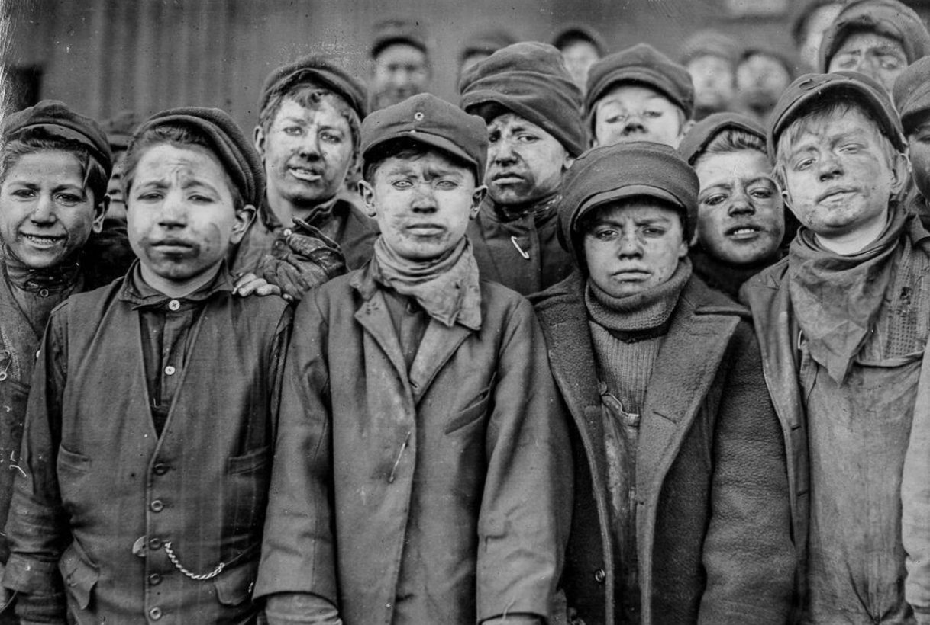
During Industrial Revolution…
had a profound effect on lives of working class people and children.
Children as young as four years old were employed in factories and mines
long working hours, dangerous conditions, little to no rights or compensation.
Also employed in coal mines, often doing physically demanding work in dangerous and crowded conditions.

Slide 9
In 1819, a doctor in Manchester reported that nearly half of the children in Lever Street school had suffered injuries from the machines.
continued to work because their families depended on their income to survive
late 19th and early 20th centuries - social reformers - abolishment of child labor - laws and regulations to protect children's rights.
several Factory Acts throughout the 1800s - limited the number of working hours and imposed regulations on workplace safety and cleanliness.

Slide 10
Causes that led to child labor
There were several factors that dragged children in factories during the Industrial Revolution. Some of the main factors include:
Poverty: Many families were struggling to make ends meet, and children were often forced to work to contribute to the family income.
Industrialization: The rise of factories and other industrial workplaces created a demand for cheap labor, and children were seen as a source of cheap and easily controlled labor.
Lack of education: There was little access to education for working-class families, so many children had limited options for employment and were forced to work in factories or mines

Slide 11
Technological advancements: The introduction of new machinery and technology made it easier for children to operate machines and perform simple tasks.
Lack of government regulation: There were few laws or regulations in place to protect children from exploitation in the workplace, so employers were free to hire children and subject them to harsh working conditions.
Social attitudes: Children were seen as expendable and were often viewed as a source of cheap labor that could be easily replaced if injured or killed on the job.

Slide 12
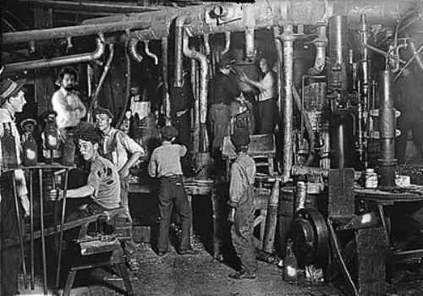
The working conditions
The child laborers worked in harsh and risky conditions in factories, mines, and other industries. Some of the most notable examples of these conditions are:
Long working hours: Children often worked 10-16 hours a day, six days a week, with no breaks. Some even worked for up to 18 hours a day in certain industries.
Low wages: Children were paid a fraction of what adult workers earned, and their wages were not enough to support their basic needs. For example, in 1835, the average weekly wage for a male worker in the textile industry was 11 shillings and 6 pence, while a child's wage was only 2 shillings and 3 pence.

Slide 13
Large Numbers: In 1833, a survey conducted in Manchester found that 55% of factory workers were children under the age of 18, and 28% of those were under the age of 10.
Dangerous machinery: Children worked with dangerous machinery that often caused injuries or fatalities. For example, in textile mills, children operated spinning machines and looms that posed a serious risk of injury.
Poor working conditions: Factories and mines were often poorly ventilated, leading to respiratory problems among child laborers. Additionally, factories were often overcrowded and poorly lit, making working conditions even worse.
Physical abuse: Many children were subjected to physical abuse by their employers, who would beat or whip them for not working hard enough or for making mistakes on the job

Slide 14
Impact on Society
Economic Impact: The availability of cheap child labor was a key factor in the growth of the textile industry during the Industrial Revolution.
Social Impact: Children were forced to work long hours in dangerous and unhealthy conditions, which often led to illness, injury, and even death.
Impact on Children: Child labor had a significant impact on the physical and emotional development of children.

Slide 15
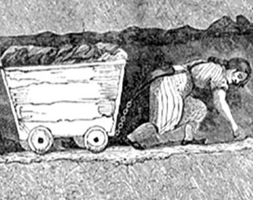
Impact on children
Nearly 1 in 10 children are subjected to child labour worldwide, with some forced into hazardous work through trafficking.
-UNICEF
Child labour can result in extreme bodily and mental harm and even death.
It can lead to slavery and sexual or economic exploitation. And in nearly every case, it cuts children off from schooling and health care, restricting their fundamental rights.

Slide 16
Impact on Education
Child labor prevents children from attending school and receiving a proper education.
Limited time for education
Poor Academic performance
Lack of motivation

Slide 17
Opposition laws

Slide 18
Why opposition started
1.Physical and Emotional Harm
2.Lack of Education
3.Family Bondage
4.Economic Inefficiency
5.Moral and Religious Obligation

Slide 19
Laws opposing child labour
1.The Factory Act of 1833 (UK) - restricting working hours, implementing education
2.The Mines Act of 1842 (UK)- children with age below 10 are prohibited
3.The Ten Hour Act of 1847 (UK) - restricting working hours to 10 hours
4.The Fair Labor Standards Act of 1938 (USA) - national minimum wage and maximum working hours for children under age 16.

Slide 20
Famous personalities who opposed child labour
1.Richard Oastler (1789-1861) - British factory reformer who advocated for shorter working hours and better conditions for child laborers
2.Lord Shaftesbury (1801-1885) - British social reformer who fought for the rights of children in the workforce, particularly in the textile mills
3.Elizabeth Barrett Browning (1806-1861) - English poet and social activist who wrote extensively about the horrors of child labor
4.Charles Dickens (1812-1870) - English novelist and social critic who used his writings to expose the terrible working conditions of children in the factories
5.Florence Kelley (1859-1932) - American social reformer who fought for laws to protect children from exploitation in the workplace

Slide 21
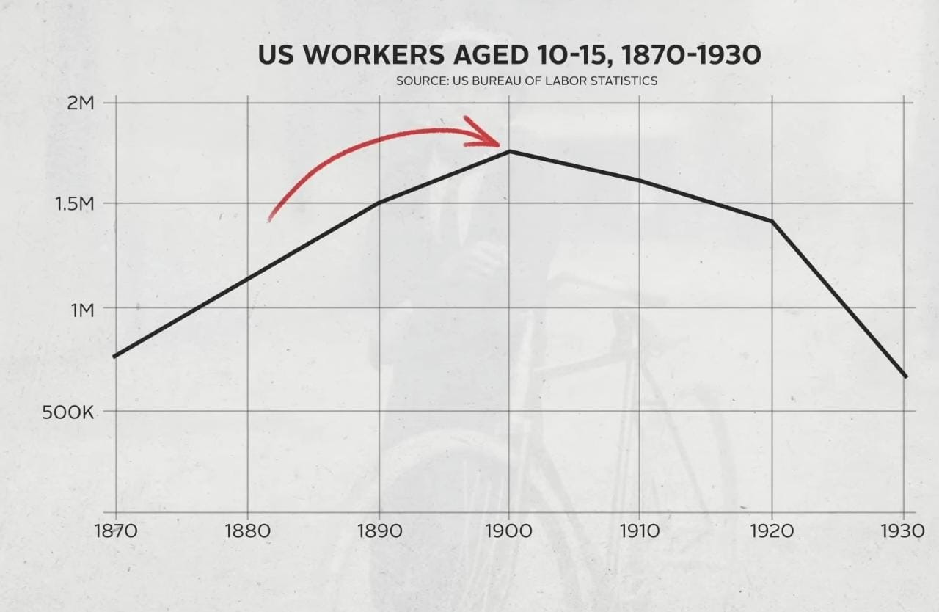
Child labour after industrial revolution

Slide 22
Global impact

Slide 23
Not only limited to Europe and North America - also present in countries like India, China etc.
In India:
India didn’t experience much increase in child labor during industrial revolution.
However,during 19th and early 20th century there was a growth of industries in india.
This growth was accompanied by the widespread of child labor in india.
And the reasons for the cause of child labor in india is also same.
(lack of education , income problems ,technological advancements)

Slide 24
Conclusion:
Few new methods to eradicate child labor
Despite rates of child labor is declining over the years ,children are still being used in some serve forms of child labor.
A total of 152 million children are estimated to be in child labor globally.
(according to data from census 2011)

Slide 25
Methods:
Social media campaigns:
1.Social media can be a powerful tool to reach millions of people in less time.
2.A well designed campaign uses social media influencers and hashtags to raise awareness about child labor and its consequences.
Strengthening laws:
1.Governments can strengthen their laws and regulations around child labor and improve enforcement mechanisms.
2.By Increasing inspections and monitorings.

Slide 26
Financial incentives:
1.Offering financial incentives to the companies that demonstrate to eradicating child labor.
Overall,there is no single method to eliminate child labor,but a combination of these methods and other innovative approaches could help to tackle this global issue.

Slide 27
Thank you
References:
S. Humphries, "Child Labor during the British Industrial Revolution," EH.Net Encyclopedia, updated March 26, 2020, https://eh.net/encyclopedia/child-labor-during-the-british-industrial-revolution/.
"Child Labour", The British Library: Discovering Literature, last modified on October 8, 2019, available at: https://www.bl.uk/romantics-and-victorians/articles/child-labour

